Slide 1

Final
PRESENTATION
March 3rd 2025
ALEXANDRIA D’ORO-GILBERT ARIANA HERRERA
MAHAMED ALI IBRAHEEM MUGABEL
Byte Brigade
GROUP 12

Slide 2
Tasks
Homepage:
Alexandria D’Oro-Gilbert
Project Manager
About Us Page:
Ariana Herrera
Communication Manager
Contact Us Page:
Ibraheem Mugabel
Project Manager
Inventory Page:
Mahamed Ali
Communication Manager

Slide 3
Client Overview
Client is owner of FADAK AUTO SALES, a new car selling business.
Located in Pacific, WA, the client is a first time business owner that is new to business.
The client wanted a simple website to be discoverable to new and current customers

Slide 4
Website Requirements
Four main pages:
Home, Car Inventory, About, and Contact Us.
For their website, they wanted to ensure that their logo was prevalent throughout the entire website.
Add in a location finder on the main home page
Wanted to display a location finder on home page
Due to this, we suggested creating an admin view in the meantime until it becomes fully functioning.

Slide 5
Challenges & Solutions
Professionalism & Simplicity
Client’s primary concern was creating a simple website for customers to easily navigate through.
Logo and Imaging
Struggled to incorporate the images throughout pages
Communication with Client
Difficult to obtain client materials due to designer delays
Contact Page
Struggled to forward the ‘Contact’ messages to business email
Notes:
*ariana

Slide 6
Home Page
Alexandria D’Oro-Gilbert

Slide 7
Home Page
Wanted to include:
Logo in the header
Navigation bar that stays at top of the page
Easy navigation to other pages through buttons
Slogan to include the business name and easier to read
Included hover attribute on the navigation bar to know what is being selected

Slide 8
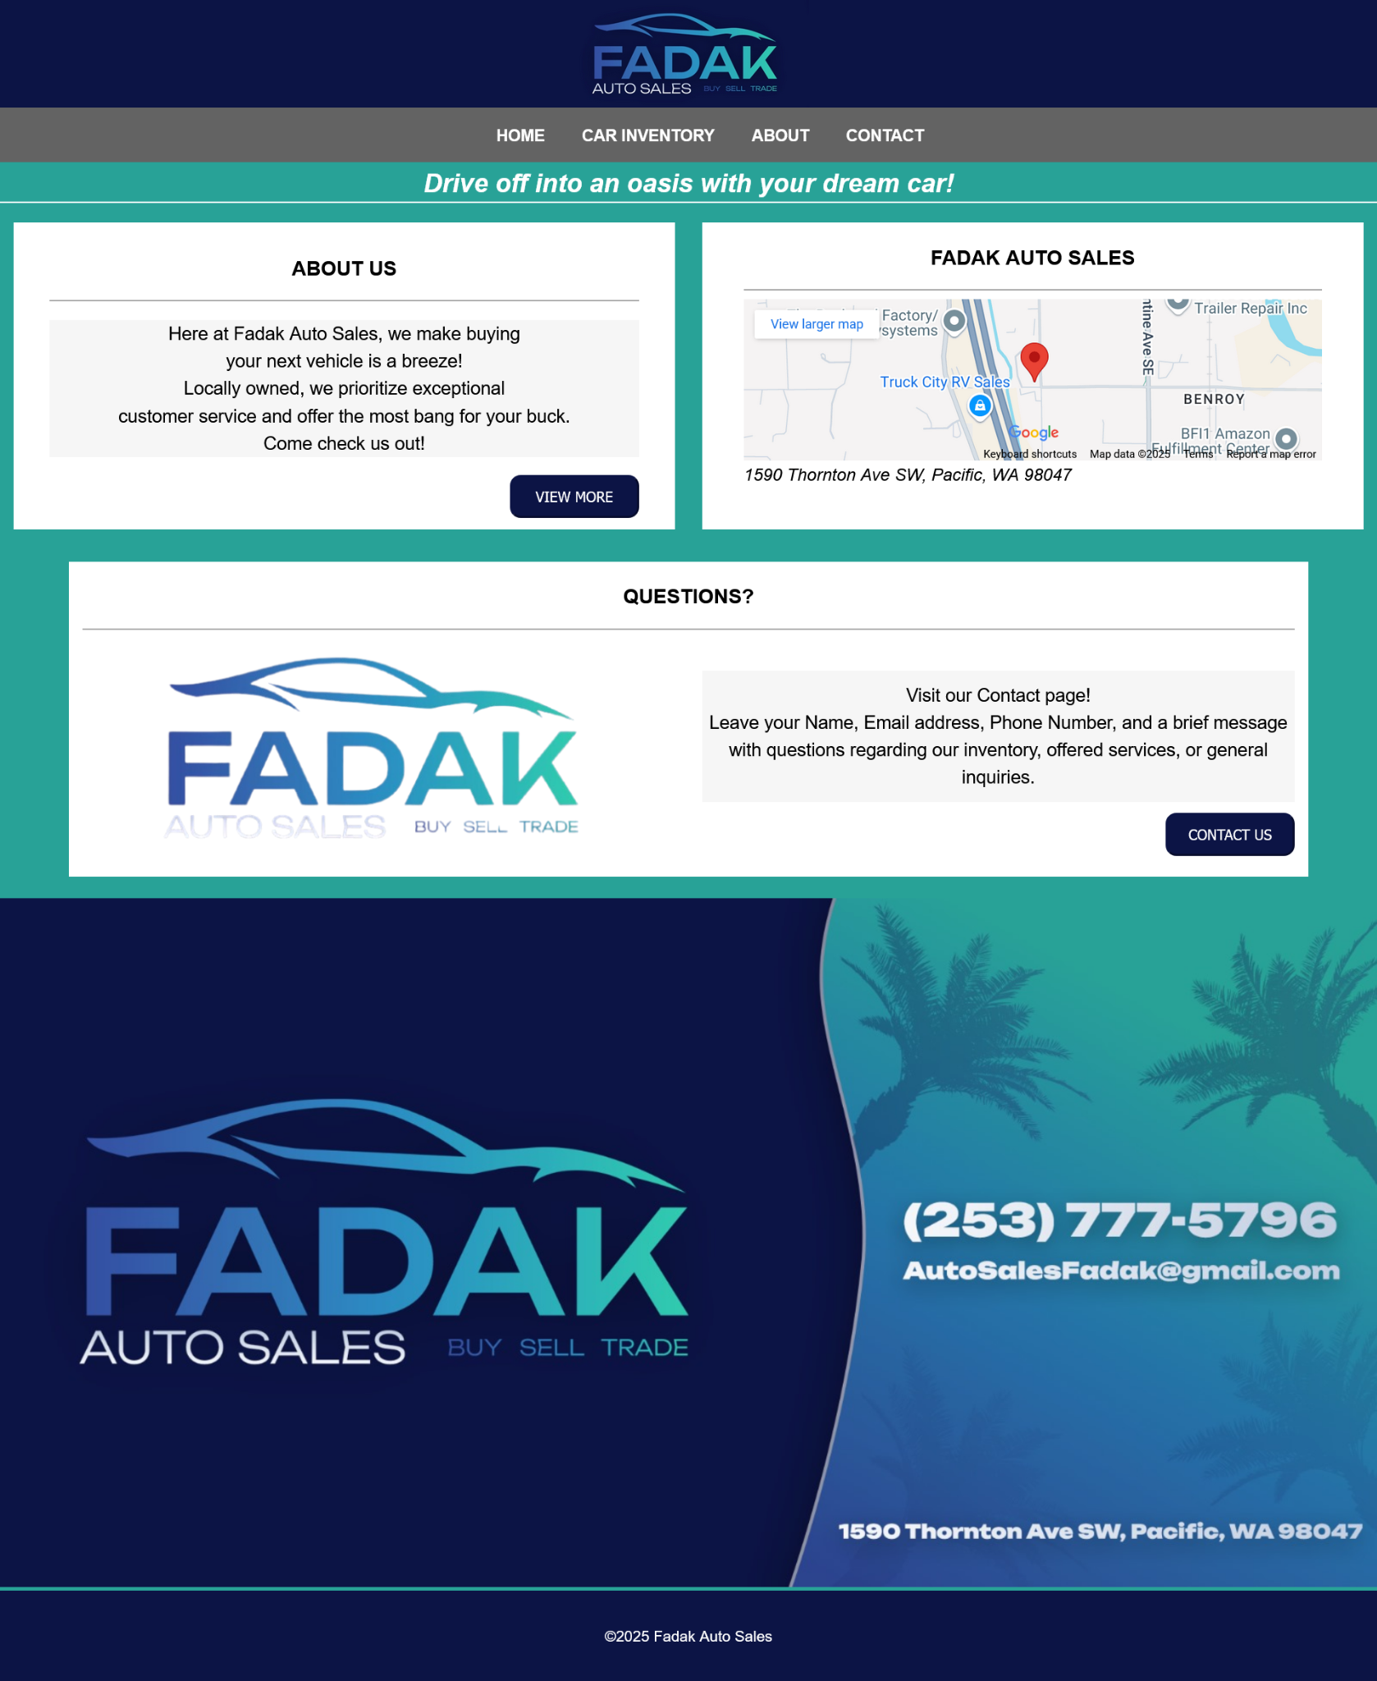

Slide 9
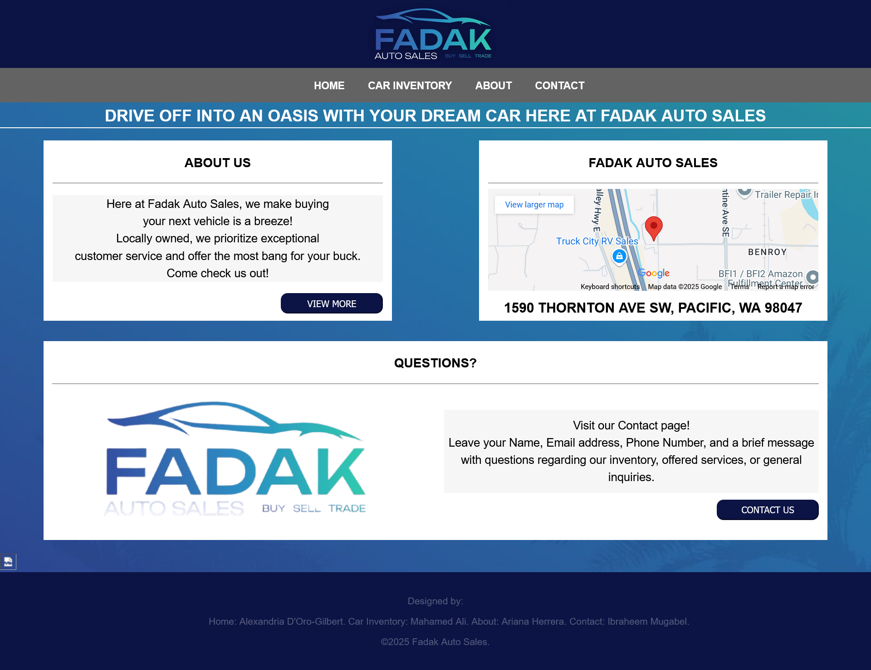

Slide 10
Car Inventory
Mahamed Ali

Slide 11
Car Inventory
The inventory displays all the cars available for sale:
Filtering Options:
To enhance the client experience, we added a filtering system that allows the client to narrow down his search based on specific criteria. For example, he can filter by:
Stock Number
Body Style
Make and Model
Price Range
Mileage
Availability Status
This feature ensures that client can quickly find the exact type of vehicle he looking for, saving them time and improving his overall experience.

Slide 12
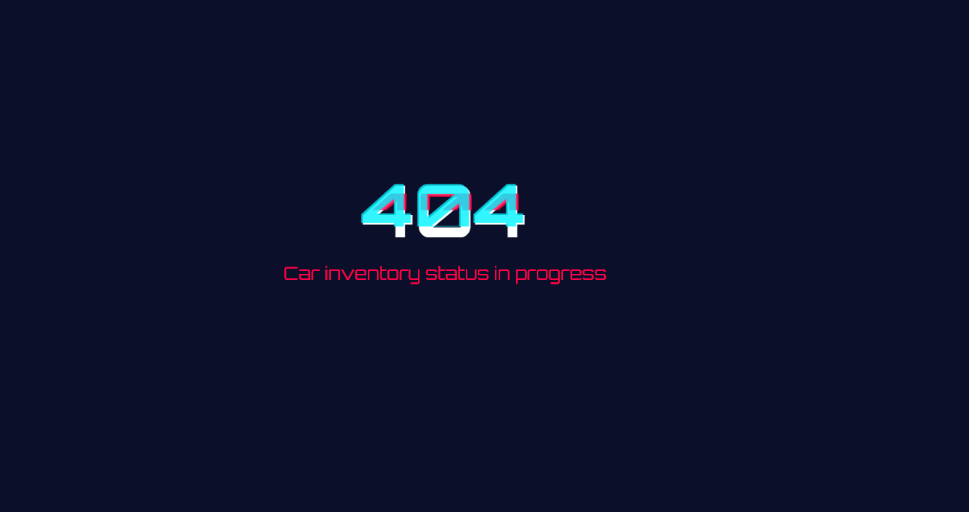

Slide 13
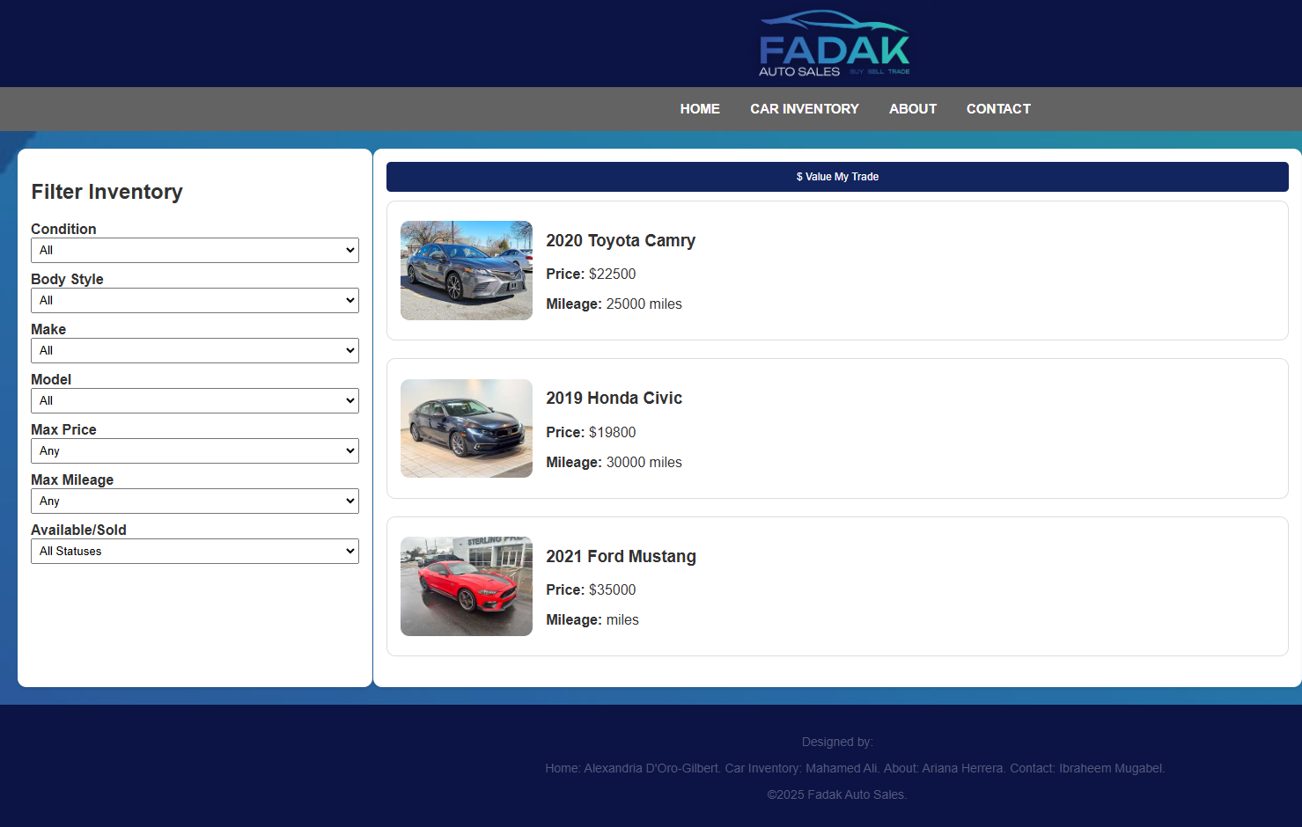

Slide 14
About Us Page
Ariana Herrera

Slide 15
About Us Page
A place to share our client’s story
While users are able to read the story, they also have access to the other website features such as
Homepage
Car Inventory
About
Contact

Slide 16
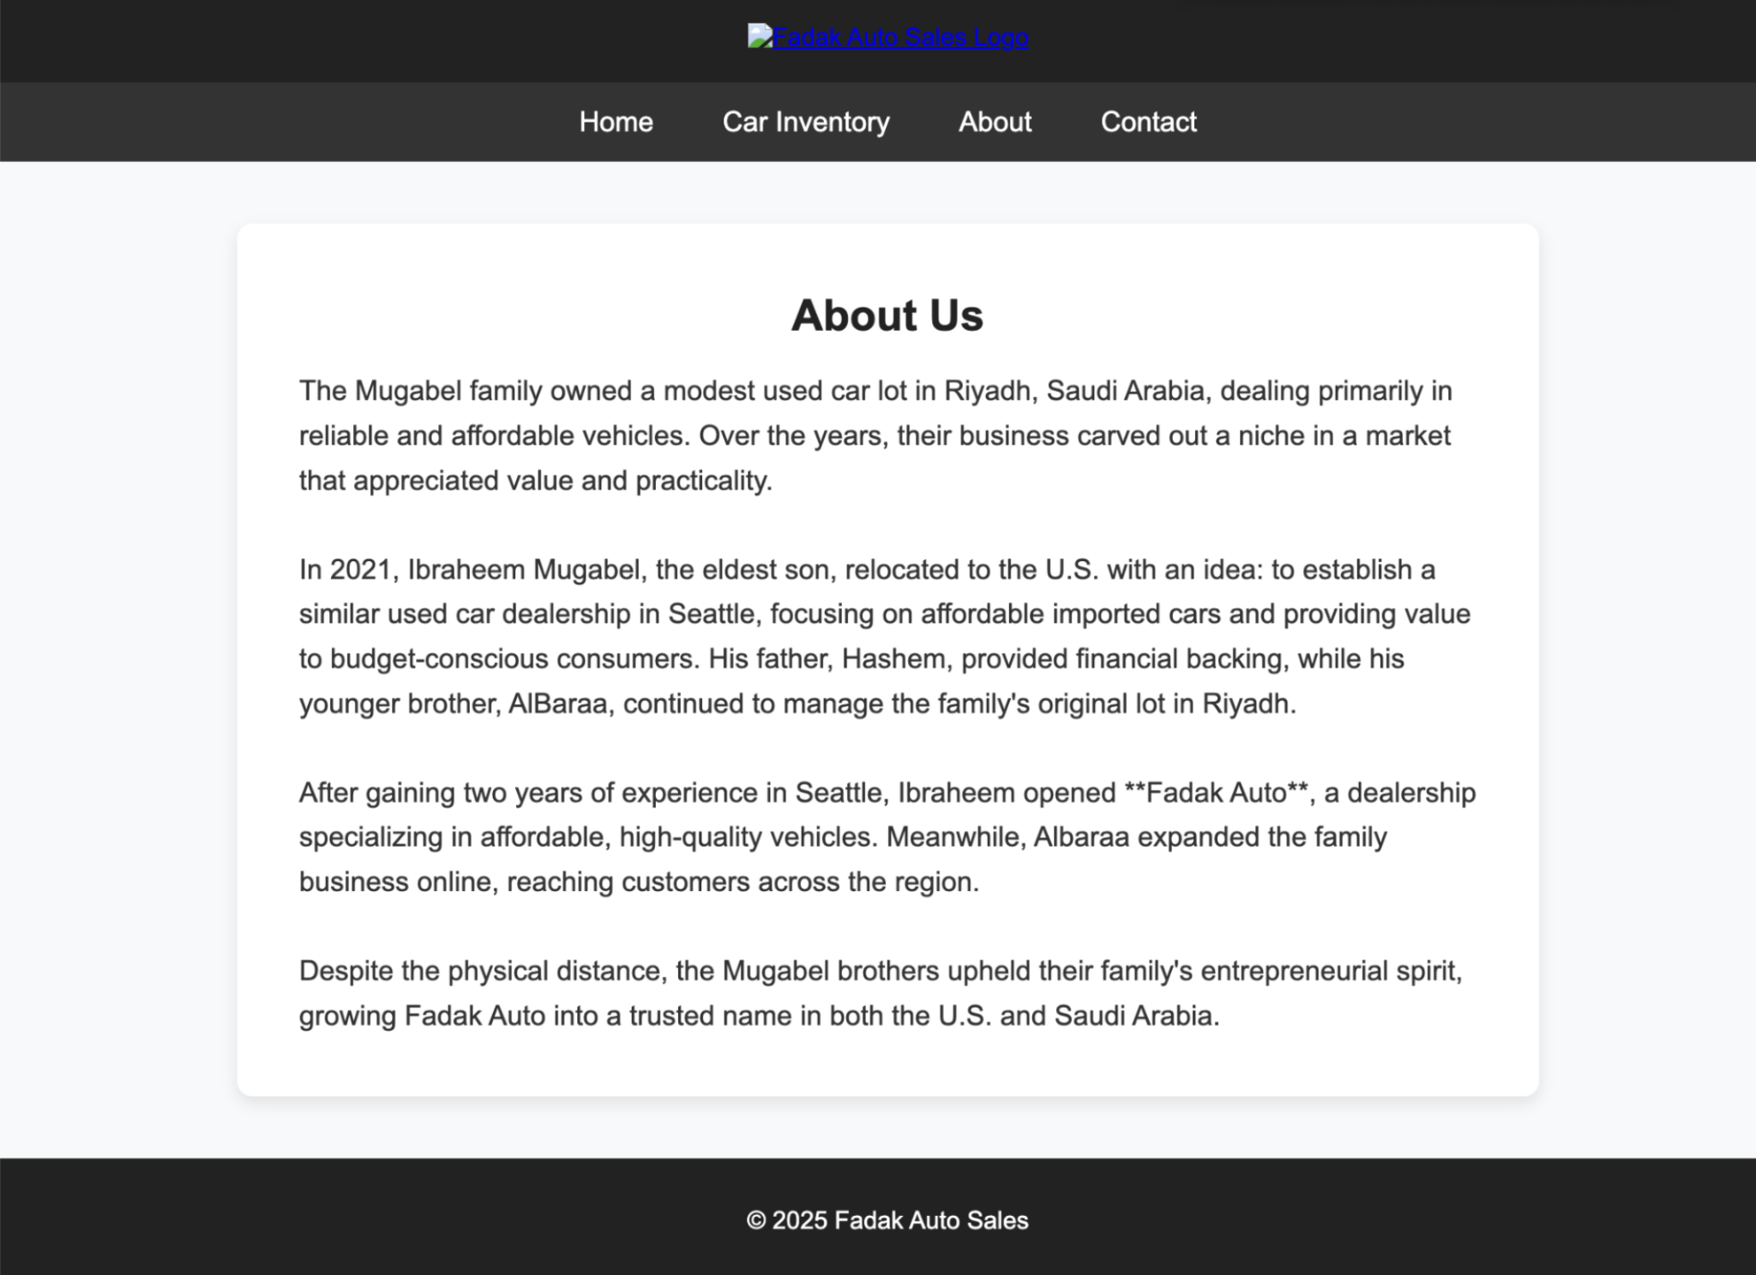
About Us Page
Old product
Didn’t approve the layout
Preferred custom background
Didn't approve the color
Updated color
Added logo

Slide 17
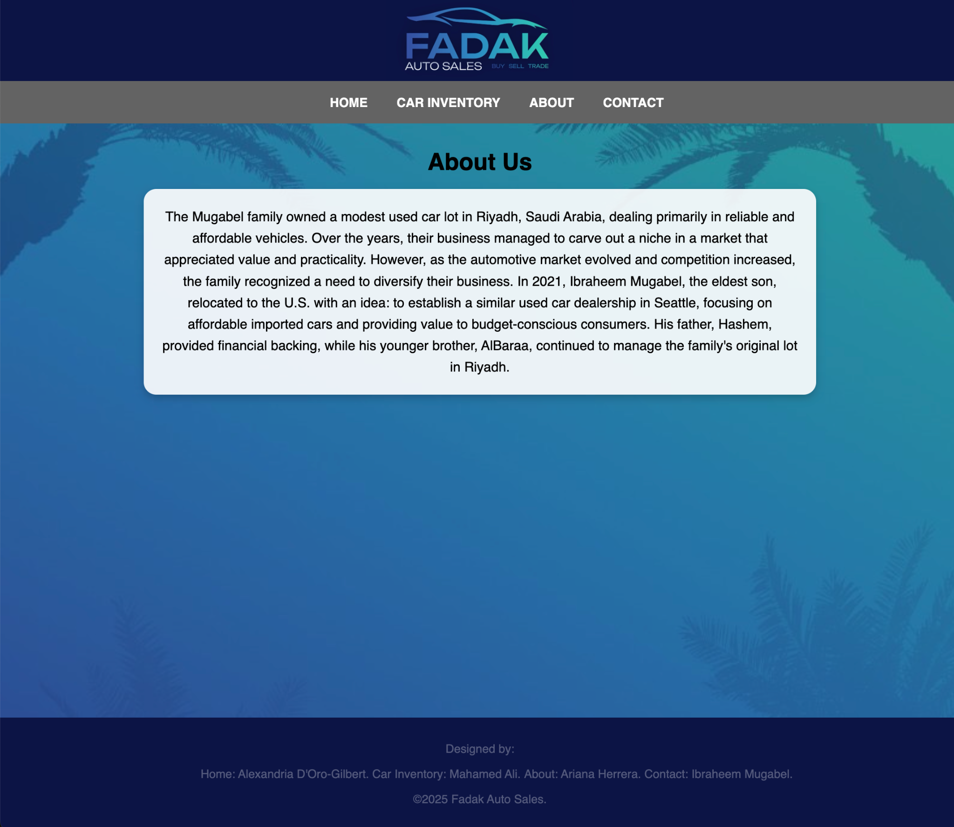
About Us Page
Centered Logo in the Header
Added Logo & Palm Tree Background
Maintained Consistency in Font & Styling
Brief Summary of Client’s Story

Slide 18
Contact Us Page
Ibraheem Mugabel

Slide 19
Contact Us Page
Use Forms to allow customers to submit their information for contact with the client

Slide 20
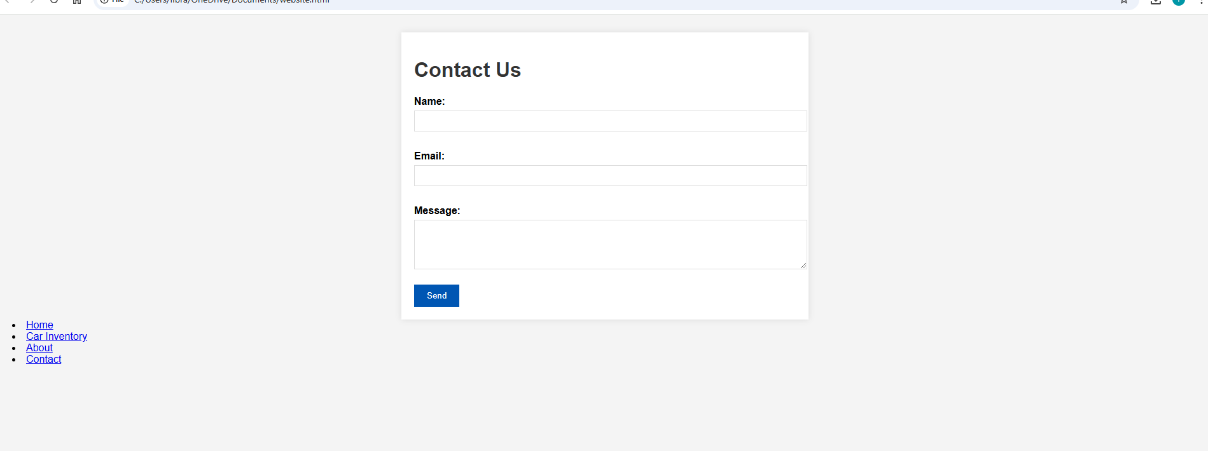

Slide 21
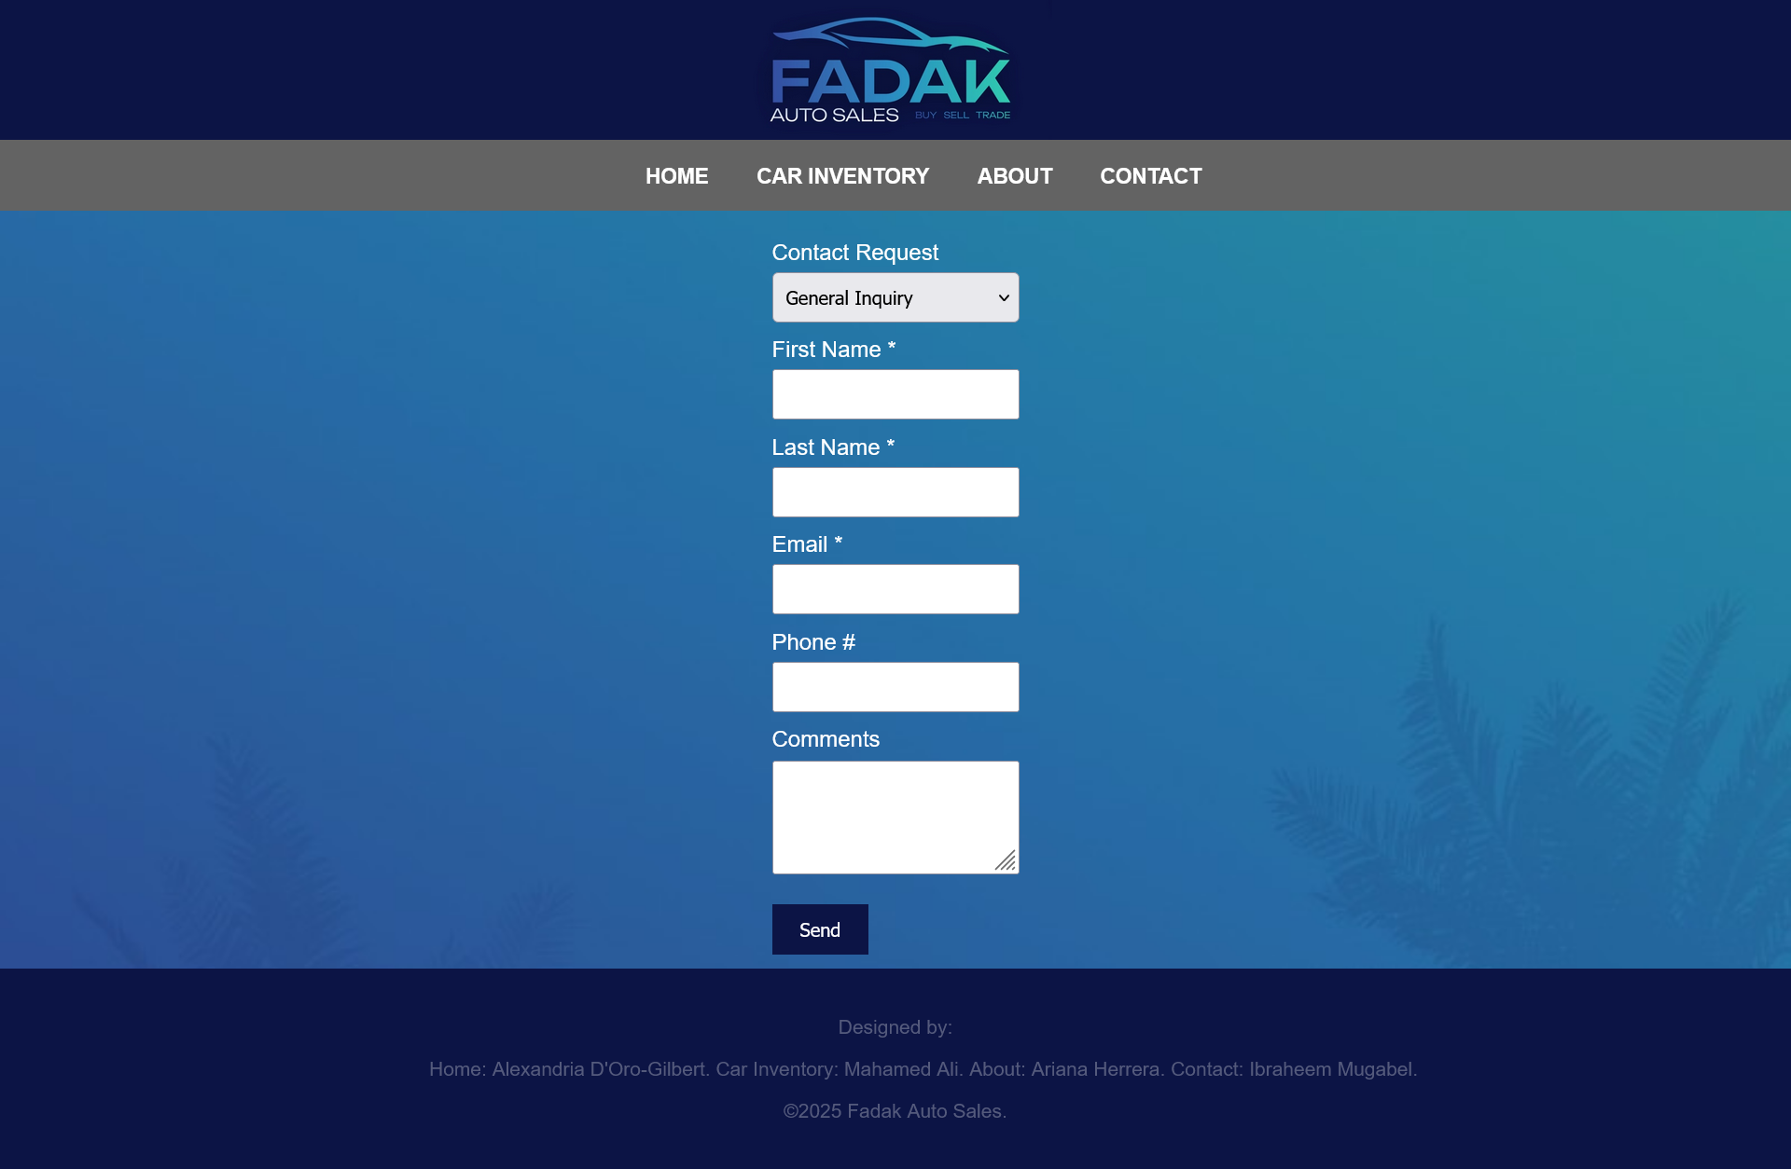

Slide 22
Website Demo
https://juicyxfu.github.io/fadak-auto-sales/

